Slide 1

Organization Visit :
MULTIMEDIA CONTENT AND COMMUNICATIONS LIMITED
Course Name: Business Studies for Engineers
Course Name: Business Studies for Engineers
Course Code: BUS 405

Slide 2
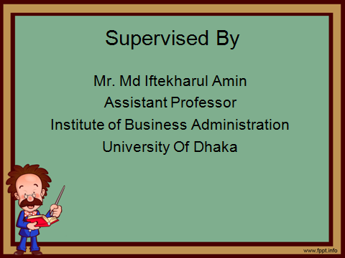

Slide 3
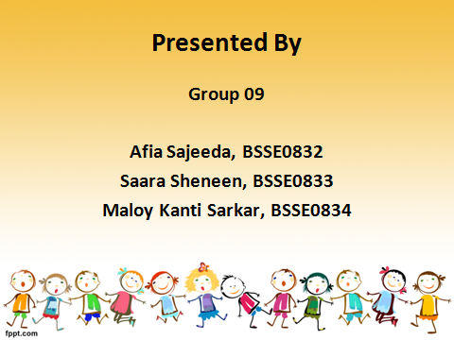

Slide 4
Presentation Outline
Aim of the project
About the Organization
Office Description
Hierarchical Structure
Recruitment System
Basic Norms of Organization
Environment

Slide 5
Aims of the Project
To experience the culture of an organization
To gain knowledge about the structure of an organization
To observe manager-employee relationship

Slide 6
ABOUT MCC LTD
Started working since 2008
Emerged as one of the most dynamic IT professionals in South Asian IT industry.
Has experience working with various local and international companies, NGOs and government organizations

Slide 7
ABOUT MCC LTD( continued)
Client portfolio includes
Mozilla, Nokia, Opera, Telenor AS, The Daily Star, Prothom Alo, Helen Keller International, Grameenphone Ltd., World Bank, USAID, Save the Children, Bangladesh Government and many others

Slide 8
ABOUT MCC LTD(continued)
The most innovative startups :
Let’s Eat
Ghurbo.com
Walleto
BD Rates.

Slide 9

Office Description
LOCATION:
6/12 Humayun Road,
Dhaka-1207,
Bangladesh

Slide 10
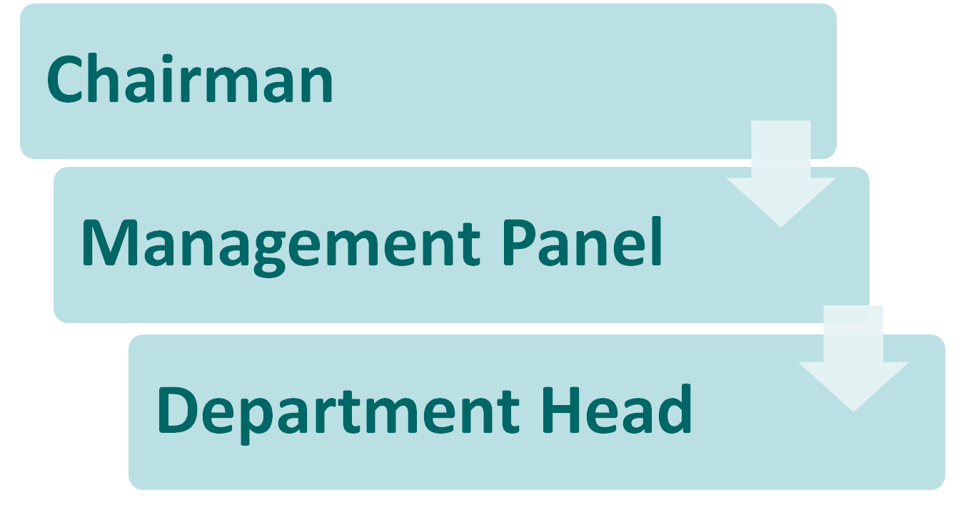
HIERARCHY

Slide 11
DEPARTMENTS
RESEARCH AND DEVELOPMENT
HR MANAGEMENT
ACCOUNTS
BUSINESS
TECHNOLOGY:
WEB TEAM
AND
MOBILE TEAM

Slide 12
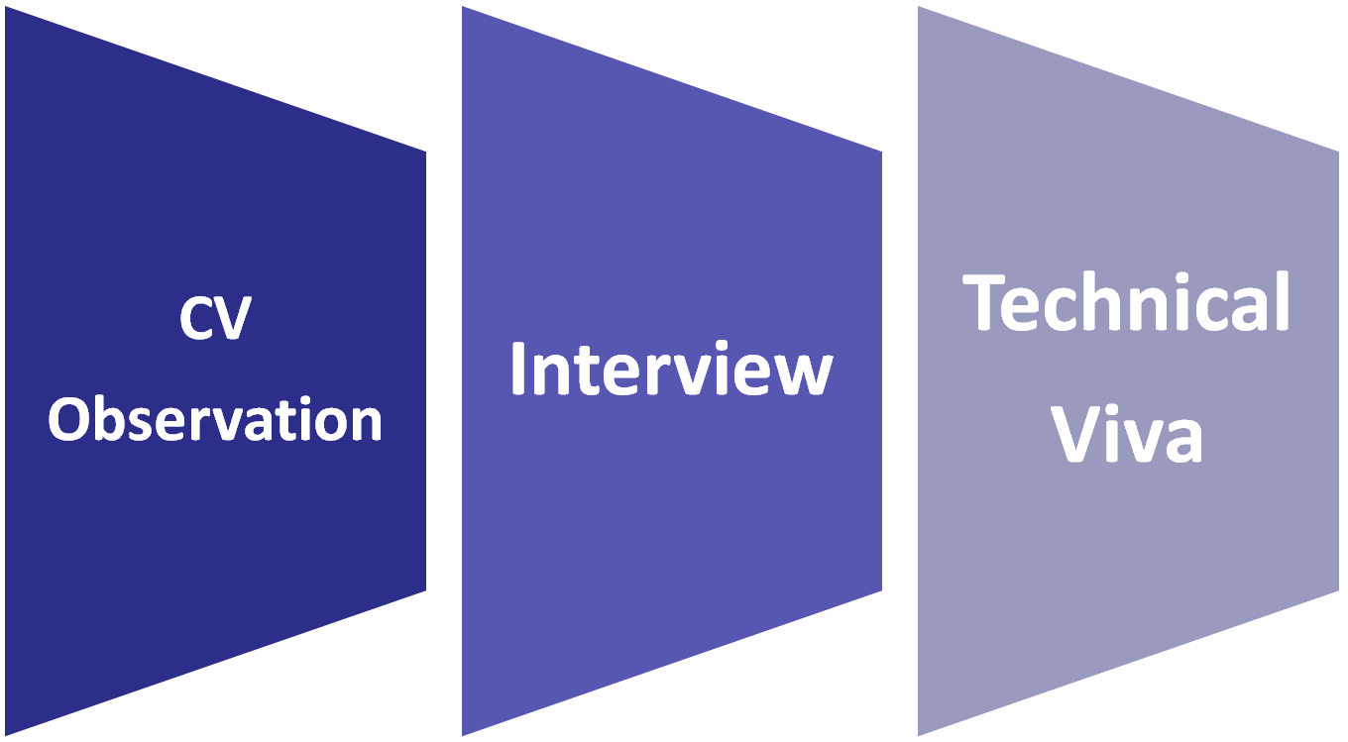
RECRUITMENT PROCESS

Slide 13
TRAINING
Duration: 6 months from date of joining
Regular discussion sessions on Thursday

Slide 14
CULTURE
Focuses on Effectiveness
Dress Code: Formal to Casual, Modest
Mandatory qualities:
Helpfulness, Co-operativeness, Punctuality
Late arrival for 3 days results in deduction of a day’s salary from the monthly salary

Slide 15
CULTURE (Continued)
Bonus twice a year
Sick leave

Slide 16
MOTIVATION
Rewards: Employee of the month
Basis: effectiveness of endeavors

Slide 17
Visions And Missions
Leading company both in Bangladesh and the Asia Pacific region
Accelerating the software industry in Bangladesh by developing world class product
Developing own solution to provide service throughout the world
Collaborations with tech giants like Google, Facebook, Microsoft

Slide 18
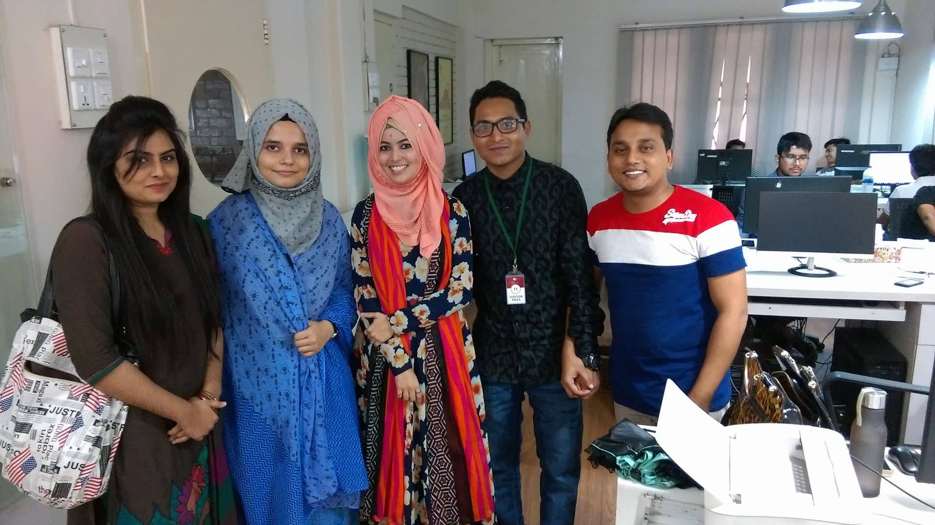
An afternoon at MCC LTD

Slide 19
THANK YOU

